Slide 1
How to Code Infographics
Here is where this template begins
This template has been created by Slidesgo

Slide 2
How to Code Infographics
Mercury
Earth
Mercury is the closest planet to the Sun and the smallest of them all
Earth is the third planet from the Sun and the only one that harbors
Venus
Mars
Venus has a beautiful name and is the second planet from
Despite being red, Mars is actually a cold place. It’s full of iron oxide
This template has been created by Slidesgo

Slide 3
How to Code Infographics
Saturn
Mercury
Venus
Earth
Mars
Jupiter
Mercury is the closest planet to the Sun
Venus is the second planet from the Sun
Earth is the third planet from the Sun
Despite being red, Mars is a cold planet
Jupiter is the biggest planet of them all
This template has been created by Slidesgo

Slide 4
How to Code Infographics
Jupiter
Venus
Neptune
Jupiter is a gas giant and the biggest planet
Venus has extremely high temperatures
Neptune is the farthest planet from the Sun
Mercury
Mars
Saturn
Mercury is the closest planet to the Sun
Despite being red, Mars is a cold place
It’s composed of hydrogen and helium
This template has been created by Slidesgo

Slide 5
How to Code Infographics
Mercury
Earth
Jupiter
Neptune
Mercury is the smallest planet of them all
Earth is the only planet known to harbor life
Jupiter is the biggest planet of them all
Neptune is the farthest planet from the Sun
Venus
Mars
Saturn
Mercury
Venus is extremely hot, even more than Mercury
Despite being red, Mars is actually a cold place
Saturn has a high number of moons, like Jupiter
Mercury is the smallest planet of them all
This template has been created by Slidesgo

Slide 6
How to Code Infographics
Mercury
Earth
Jupiter
Neptune
Mercury is a small planet
Earth is the planet with life
Jupiter is a huge gas giant
Neptune is far away from us
Venus
Mars
Saturn
Mercury
Venus is a very hot planet
Mars is made of basalt
Saturn is the ringed planet
Mercury is a small planet
This template has been created by Slidesgo

Slide 7
How to Code Infographics
Mercury
Earth
Mercury is the closest planet to the Sun and the smallest of them all
Earth is the third planet from the Sun and the only one that harbors
Venus
Mars
Venus has a beautiful name and is the second planet from
Despite being red, Mars is actually a cold place. It’s full of iron oxide
This template has been created by Slidesgo

Slide 8
How to Code Infographics
Venus
Mars
Saturn
Venus is the second planet from the Sun
Despite being red, Mars is very cold
Saturn is the ringed planet
Mercury
Earth
Jupiter
Mercury is the closest planet to the Sun
Earth is the third planet from the Sun
Jupiter is the biggest planet of them all
This template has been created by Slidesgo

Slide 9
How to Code Infographics
Mercury
Earth
Mercury is the closest planet to the Sun and the smallest of them all
Earth is the third planet from the Sun and the only one that harbors
Venus
Mars
Venus has a beautiful name and is the second planet from
Despite being red, Mars is actually a cold place. It’s full of iron oxide
This template has been created by Slidesgo

Slide 10
How to Code Infographics
Mercury
Mars
Mercury is the closest planet to the Sun and the smallest
Despite being red, Mars is actually a cold place. It’s full of iron
Venus
Jupiter
Venus has a beautiful name, but also high temperatures
Jupiter is a gas giant and the biggest planet in the Solar
Earth
Saturn
Earth is the third planet from the Sun and the only one
Saturn is a gas giant and has several rings. It’s composed
This template has been created by Slidesgo

Slide 11
How to Code Infographics
Mercury is the closest planet to the Sun and the smallest planet of them all
Earth is the third planet from the Sun and the only one that harbors
Mercury
Earth
Venus has a beautiful name and is the second planet from the Sun
Despite being red, Mars is actually a cold place. It’s full of iron oxide
Venus
Mars
This template has been created by Slidesgo

Slide 12
How to Code Infographics
A
Mercury
Mercury is the smallest planet of them all
B
Venus
Venus is extremely hot, even more than Mercury
C
Earth
Earth is the only planet known to harbor life
This template has been created by Slidesgo

Slide 13
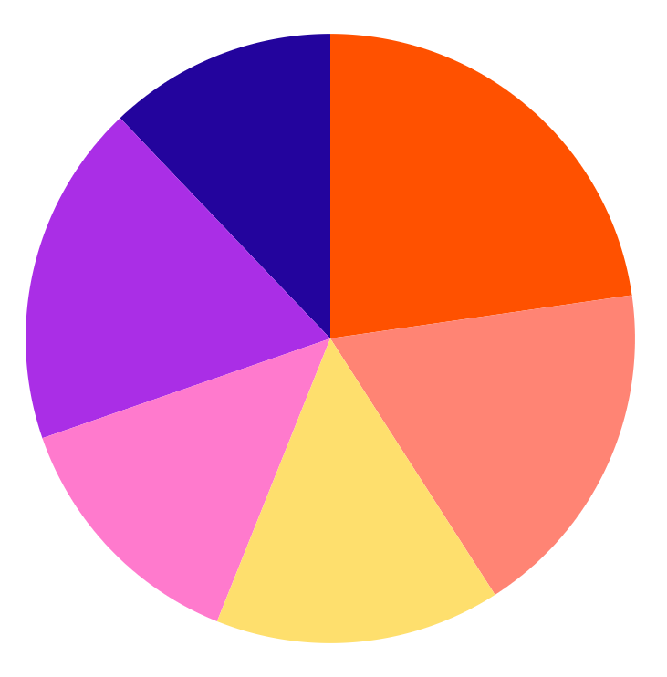
How to Code Infographics
Mercury
Mars
Mercury is the closest planet to the Sun and the smallest
8%
15%
Despite being red, Mars is actually a cold place. It’s full of iron
Venus
Jupiter
Venus has a beautiful name and is the second planet from
12%
12%
Jupiter is a gas giant and the biggest planet in the Solar
Earth
Saturn
Earth is the third planet from the Sun and the only one
9%
10%
Saturn is a gas giant and has several rings. It’s composed
This template has been created by Slidesgo

Slide 14
How to Code Infographics
Mercury
Earth
Mercury is the closest planet to the Sun and the smallest of them all
Earth is the third planet from the Sun and the only one that harbors
Venus
Mars
Venus has a beautiful name and is the second planet from
Despite being red, Mars is actually a cold place. It’s full of iron oxide
This template has been created by Slidesgo

Slide 15
How to Code Infographics
Mercury
Saturn
Mercury is the closest planet to the Sun and the smallest
Saturn is a gas giant and has several rings. It’s composed
Venus
Jupiter
Venus has a beautiful name, but also high temperatures
Jupiter is a gas giant and the biggest planet in the Solar
Earth
Mars
Earth is the third planet from the Sun and the only one
Despite being red, Mars is actually a cold place. It’s full of iron
This template has been created by Slidesgo

Slide 16
How to Code Infographics
Mercury is the closest planet to the Sun and the smallest of them all
1
Mercury
2
Venus has a beautiful name and is the second planet from the Sun
Venus
Earth is the third planet from the Sun and the only one that harbors life
3
Earth
4
Despite being red, Mars is actually a cold place. It’s full of iron oxide dust
Mars
This template has been created by Slidesgo

Slide 17
How to Code Infographics
Mercury
Jupiter is the biggest planet in the Solar System
Jupiter
Mercury is the closest planet to the Sun and the smallest one in the entire Solar System
Venus is extremely hot, even more than Mercury
Venus
Earth is the third planet from the Sun and has life
Earth
This template has been created by Slidesgo

Slide 18
How to Code Infographics
Mercury
Venus
Earth
Mercury is the closest planet to the Sun and the smallest planet in the Solar System
Venus has a beautiful name and is the second planet from the Sun
Earth is the third planet from the Sun and the only one that harbors life
This template has been created by Slidesgo

Slide 19
How to Code Infographics
How to Code Infographics {} <> </> [,]...
List No. | Saturn | Mercury | Mars | Jupiter
Step 1 | Saturn has a high number of moons, like Jupiter | Mercury is the closest planet to the Sun | Despite being red, Mars is actually a cold place | Jupiter doesn’t have a solid surface
Step 2 | Saturn is a gas giant and has several rings | Mercury is the smallest planet of them all | Mars is full of iron oxide dust and it is made of basalt | Jupiter was named after a Roman god
This template has been created by Slidesgo

Slide 20
Icon pack
This template has been created by Slidesgo

Slide 21
Instructions for use (premium users)
As a Premium user, you can use this template without attributing Slidesgo.
You are allowed to:
Modify this template.
Use it for both personal and commercial purposes.
Share this template in an editable format with people who are not part of your team.
You are not allowed to:
Sublicense, sell or rent this Slidesgo Template (or a modified version of this Slidesgo Template).
Distribute this Slidesgo Template (or a modified version of this Slidesgo Template) or include it in a database or in any other product or service that offers downloadable images, icons or presentations that may be subject to distribution or resale.
Use any of the elements that are part of this Slidesgo Template in an isolated and separated way from this Template.
Register any of the elements that are part of this template as a trademark or logo, or register it as a work in an intellectual property registry or similar.
For more information about editing slides, please read our FAQs or visit our blog:
https://slidesgo.com/faqs and https://slidesgo.com/slidesgo-school

Slide 22
Infographics
You can add and edit some infographics to your presentation to present your data in a visual way.
Choose your favourite infographic and insert it in your presentation using Ctrl C + Ctrl V or Cmd C + Cmd V in Mac.
Select one of the parts and ungroup it by right-clicking and choosing “Ungroup”.
Change the color by clicking on the paint bucket.
Then resize the element by clicking and dragging one of the square-shaped points of its bounding box (the cursor should look like a double-headed arrow). Remember to hold Shift while dragging to keep the proportions.
Group the elements again by selecting them, right-clicking and choosing “Group”.
Repeat the steps above with the other parts and when you’re done editing, copy the end result and paste it into your presentation.
Remember to choose the “Keep source formatting” option so that it keeps the design. For more info, please visit our blog.

